Slide 1
Introduction to
Cyber Physical Systems

Slide 2
The Next Computing Revolution
Mainframe computing (60’s – 70’s)
Large computers to execute big data processing applications
Desktop computing & Internet (80’s – 90’s)
One computer at every desk to do business/personal activities
Ubiquitous computing (00’s)
Numerous computing devices in every place/person
Millions for desktops vs. billions for embedded processors
Cyber Physical Systems (10’s)

Slide 3
What are Cyber Physical Systems?
Cyber Physical System is a system featuring a tight combination of, and coordination between, the system’s computational and physical elements.
CPS uses computations and communication deeply embedded in and interacting with physical processes to add new capabilities to physical system.
from miniscule to large-scale systems
dependably, safely, securely, efficiently and in real-time
Convergence of computation, communication, and control

Slide 4
Why Cyber Physical Systems?
Embedded computers allow us to add capabilities to physical systems.
Computer-controlled automotive engines are fuel-efficient and low-emission.
By merging computing and communication with physical processes, CPS brings many benefits:
Safer and more efficient systems
Reduce the cost of building and operating systems
Could form complex systems that provide new capabilities
Technological and Economic Drivers
The decreasing cost of computation, networking, and sensing provides the economic motivation.
Computers and communication are ubiquitous enables national or global scale CPSs. (eg. national power grid, national transportation network)
Social and economic forces require more efficient use of national infrastructure.
Environmental pressures make new technologies appear to improve energy efficiency and reduce pollution.

Slide 5
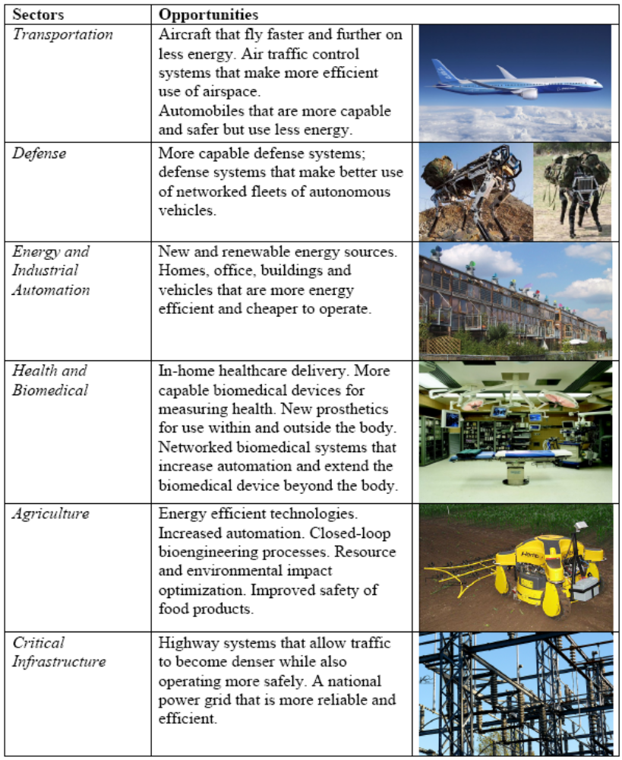
CPS Created Opportunities

Slide 6
What new things needed?
New vocabulary of components
Some components could adapt themselves automatically to other components, but we wish more reusable components.
New methods for designing and testing systems
In 1970s, people use mechanical tools to make and test systems. Now we use computers to test systems.
Workforce with new skills
CPS depends more on software and electronics.

Slide 7
Science and Technology Challenges
Not possible to identify whether behavioral attributes are the result of computations, physical laws, or together.
Separation of information science and physical science creates a divergence in scientific foundations.
Dominant abstractions in programming languages avoid the explicit representation of physical aspects.
Physical processes neglect the importance of the properties of computing and communication platforms.
Simple combination of physical process and computational process will be inefficient and unsafe.

Slide 8
Science and Technology Challenge
Compositionality: system-level properties can be computed from local properties of components
Composability: component properties are not changing as a result of interactions with other components.
CPS are heterogeneous in components and design requirements.
Separation of concerns would work for multi-objective design if the design views are orthogonal which is not true for CPS.
Today’s application-oriented organization does not scale to the large, heterogeneous CPS.
CPS products make design flows product specific which is bad for design automation.
The cost of certification of complex systems is high.
Security issues. One side can be attacked through the other side.

Slide 9
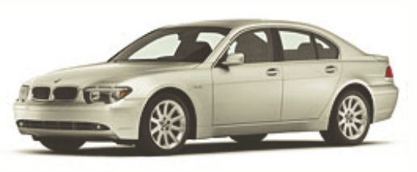
Example: Automotive Telematics
In 2005, 30 – 90 processors per car
Engine control, Break system, Airbag deployment system
Windshield wiper, Door locks, Entertainment system
Cars are sensors and actuators in V2V networks
Active networked safety alerts
Autonomous navigation
Future Transportation Systems
Incorporate both single person and mass transportation vehicles, air and ground transportations.
Achieve efficiency, safety, stability using real-time control and optimization.

Slide 10
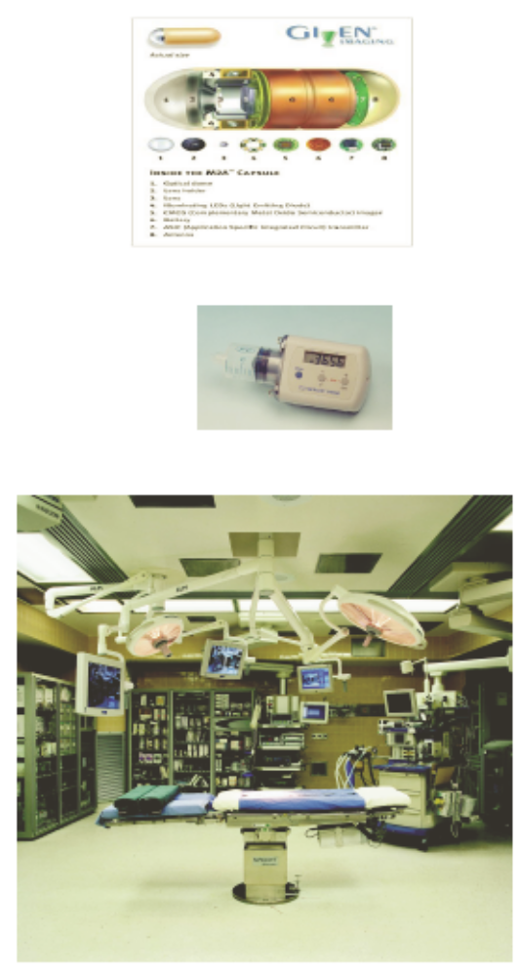
Example: Health Care and Medicine
National Health Information Network, Electronic Patient Record
Home care: monitoring and control
Pulse oximeters, blood glucose monitors, infusion pumps, accelerometers, …
Operating Room of the Future
Closed loop monitoring and control; multiple treatment stations, plug and play devices; robotic microsurgery
System coordination challenge
Progress in bioinformatics: gene, protein expression, systems biology, disease dynamics, control mechanisms

Slide 11
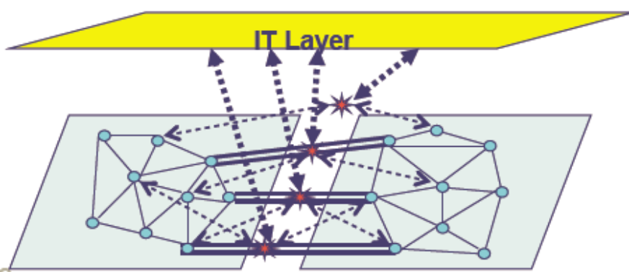
Example: Electric Power Grid
Current picture:
Equipment protection devices trip locally, reactively
Cascading failure
Better future?
Real-time cooperative control of protection devices
Self-healing, aggregate islands of stable bulk power
Coordinate distributed and dynamically interacting partcipants
Issue: standard operational control concerns exhibit wide-area characteristics (bulk power stability and quality, flow control, fault isolation)

